Slide 1




Course name: engineering mathematics-iII
B.TECH Second YEAR
Academic YEAR: 2020-2021
Course code : ma 2101
lecture series no : 0 4
Credits : 3
Mode of delivery : online (Power point presentation)
Faculty : Dr. Alok Bhargava
Email-id : pooja.sharma@jaipur.manipal.edu
PROPOSED DATE OF DELIVERY: 20 August 2020

Slide 2

Session outcome
“Understanding of diagrammatic presentation of Posets”

Slide 3
Hasse Diagrams
Like relations and functions, partial orders have a convenient graphical representation:
Poset Diagram (Hasse Diagram): A graph representing a poset but with only immediate predecessor edges, and the edges are oriented up from x to y when x < y.

Slide 4
Hasse Diagrams – Consider the digraph representation of a partial order –
Because we are dealing with a partial order, we know that the relation must be reflexive and transitive – Thus, we can simplify the graph as follows
Remove all self loops
Remove all transitive edges
Remove directions on edges assuming that they are oriented upwards – The resulting diagram is far simpler

Slide 5
Hasse Diagrams
Consider the graph for a finite poset ({1,2,3,4},≤)
When we know it’s a poset, we can simplify the graph
4
3
2
1
4
3
2
1
4
3
2
1
4
3
2
1
Called the
Hasse
diagram

Slide 6
• Of course, we need not always start with the complete relation in the partial order and then trim everything. •
Rather, we can build a Hasse Diagram directly from the partial order
• Example:
{a, b, c}
{a, b}
{a, c}
{b, c}
{a}
{b}
{c}
The poset ⟨ power({a, b, c}), ⊆ ⟩ has the poset
diagram shown in the picture.
∅

Slide 7
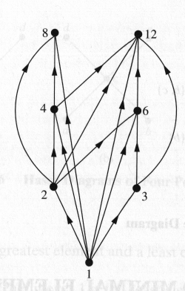
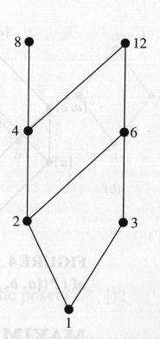
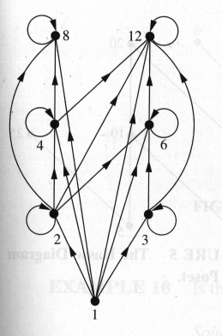
Hasse Diagrams
Example: For the poset ({1,2,3,4,6,8,12}, |)

Slide 8
Hasse Diagrams
Example: Let A = {1, 2, 3, 4, 12}. Consider the partial order of divisibility on A. That is for a and b ∈ A, a ≤ b if and only if a|b. Draw the Hasse diagram of the poset (A, ≤)
12
4
3
2
1

Slide 9
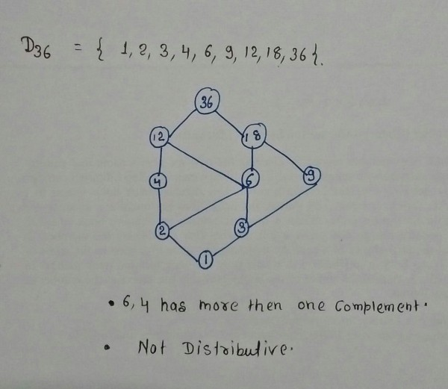
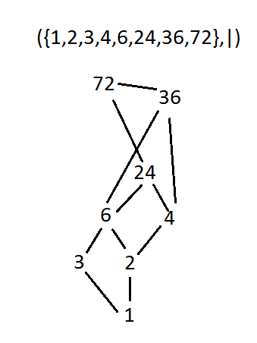

Slide 10
Minimal Elements
Let (A, ≤ ) be a poset. An element a ϵ A is called a minimal element, if there is no element b ϵ A such that b ≠ a and b ≤ a.
A minimal element in a poset need not be unique.
All those elements which appear at the lowest level of Hasse diagram of a partially ordered set are minimal elements.

Slide 11
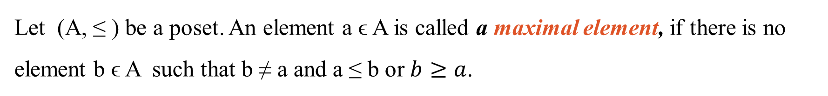
Maximal Elements
Let (A, ≤ ) be a poset. An element a ϵ A is called a maximal element, if there is no element b ϵ A such that b ≠ a and a ≤ b or $b≥a$.
A maximal element in a poset need not be unique.
All those elements which appear at the highest level of Hasse diagram of a partially ordered set are maximal elements.

Slide 12
Maximal & Minimal Elements
It is not necessary for a poset to have any minimal or maximal elements.
For example, the set of all the integers with usual ≤ relation has no minimal or maximal elements.
Every finite poset has at least one minimal element.
Every finite poset has at least one maximal element.

Slide 13
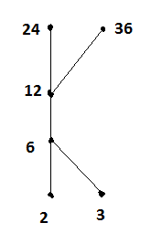
For the set X = { 2,3,6,12,24,36}, a relation ≤ is defined as x ≤ y if x divides y. Draw the Hasse diagram for (X,≤)
R={(2,2),(2,6),(2,12),(2,24),(2,36),(6,6),(6,12),(6,24),(6,36),(12,12),(12,24),(12,36),(24,24),(3,3),(3,6),(3,12),(3,24),(3,36)}
What are the maximal and minimal elements ?
Maximal elements : 24, 36
Minimal elements : 2, 3

Slide 14
Bounds
Let S be a subset of a poset
.
An element u ϵ A, is called an upper bound for S if x ≤ u for all x ϵ S.
An element v ϵ A, is called a lower bound for S if v ≤ x for all x ϵ S.
The subset S need not have either an upper bound or a lower bound. Even if S has an upper bound and/or lower bound, it is not necessary that they belong to S.

Slide 15
Least Element and Greatest Element
Let S be a subset of a poset
.
An element c ϵ S, is called the least element of S if c ≤ x for all x ϵ S. The set S can have at most one least element.
An element d ϵ S, is called the greatest element of S if x ≤ d for all x ϵ S. The set S can have at most one greatest element.

Slide 16
Greatest lower bound
If the set of lower bounds of S has a greatest element, then this element is called the greatest lower bound (glb) or infimum of S written as glb(S) or inf(S). A greatest lower bound, if it exists, is unique.
Least upper bound
If the set of upper bounds of S has a least element, then this element is called the least upper bound (lub) or supremum of S written as lub(S) or sup(S). A least upper bound, if it exists, is unique

Slide 17
Example: Answer the following questions for the poset represented by the given Hasse diagram:
Find the maximal elements.
Find the minimal elements.
Is there any greatest element?
Is there any least element?
Find all the upper bounds of {a,b,c}
Find the least upper bound (supremum) of {a,b,c} if it exists.
Find all the lower bounds of {f,g,h}
Find the greatest lower bound (infimum) of {f, g, h}, if it exist.

Slide 18
Thanks

